Slide 1

GRANULAR COMPUTING: A NEW PROBLEM-SOLVING PARADIGM
Idriss JAIRI
Idriss.jairi@univ-lille.fr

Slide 2
COURSE PLAN
Part 1: Introduction to Granular Computing
Part 2: Granular Computing Frameworks
Part 3: Granular Computing Applications

Slide 3
PART 1: introduction to granular COMPUTING
What is Granular Computing (GrC)

Slide 4
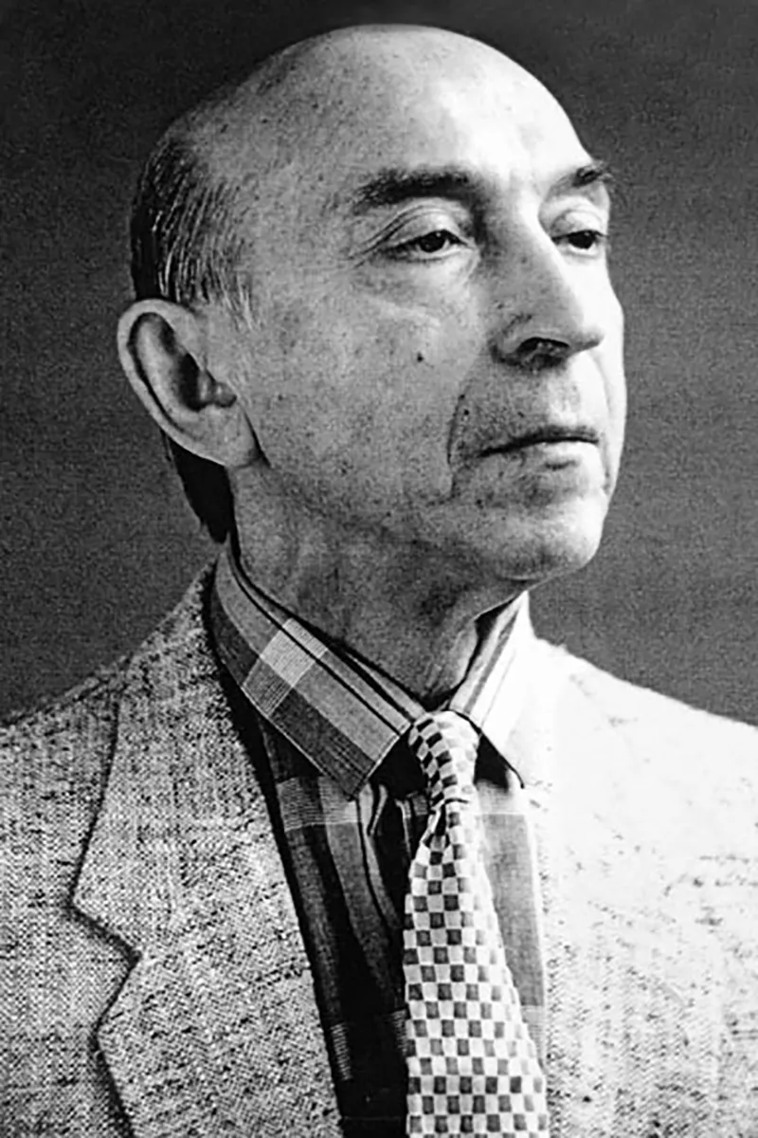
Introduction to Granular Computing (GrC)
The concept of GrC was initially called information granularity or information granulation and was introduced by Zadeh [1] in 1979. [1] Zadeh, Lotfi A. "Fuzzy sets and information granularity." Fuzzy sets, fuzzy logic, and fuzzy systems: selected papers (1979): 433-448.
The term granular computing (GrC) first appeared in 1997 by Zadeh [2]. [2] Zadeh, Lotfi A. "Toward a theory of fuzzy information granulation and its centrality in human reasoning and fuzzy logic." Fuzzy sets and systems 90.2 (1997): 111-127.
Lotfi A. Zadeh
Mathematician and computer scientist

Slide 5
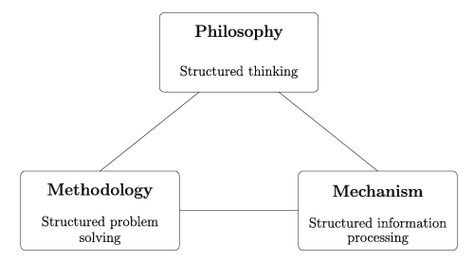
Introduction to Granular Computing (GrC)
Lotfi A. Zadeh considers granular computing as the basis for computing with words, i.e., computation with the information described in natural language.
Yiyu Yao (Y.Y. Yao) views granular computing as a complementary and dependent triangle: structured thinking from a philosophical perspective, structured problem-solving from a methodological perspective, and structured information processing from a computational perspective.
Fig: The granular computing triangle

Slide 6
Introduction to Granular Computing: Definitions
Definition 1: Granular computing can be defined as an umbrella term to cover any theories, methodologies, techniques, and tools that make use of granules in complex problem solving. The process of performing computation and operations on granules
Definition 2: GrC is a general computation theory that imitates human thinking and reasoning by dealing with information as a form of aggregates called information granules

Slide 7
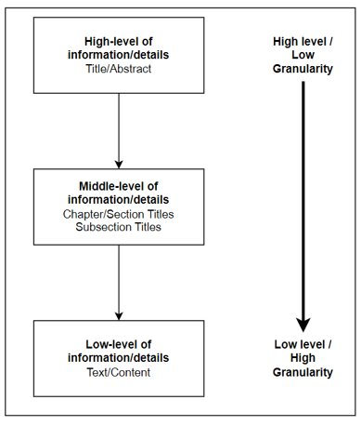
Introduction to Granular Computing
Technical writing:
One can easily observe multiple levels of processing information in any technical writing:
High level of information:
Title
Abstract
Middle level of information:
Chapter/section titles
Subsection titles
Subsubsection titles
Low level of information
Text/content
Figure: A simple illustration of different levels of granularity

Slide 8
Introduction to Granular Computing: Information Granularity
Temperature, precipitation, and wind data recorded in Northern Alberta over the recent weeks.
Information Granulation
Recently(Temporal granulation) recorded very high (temperature granulation) temperature, around zero (precipitation granulation) precipitation, and strong (wind granulation) wind in northern (spatial granulation) Alberta

Slide 9
Introduction to Granular Computing: Information Granularity
Weather: temperature forecast in the coming days
Temperature in [-10C, 35C]
Temperature in [15C, 25C]
Temperature in [17C, 21C]
Temperature 18.65C
Specificity
Abstraction
(Data coverage)

Slide 10
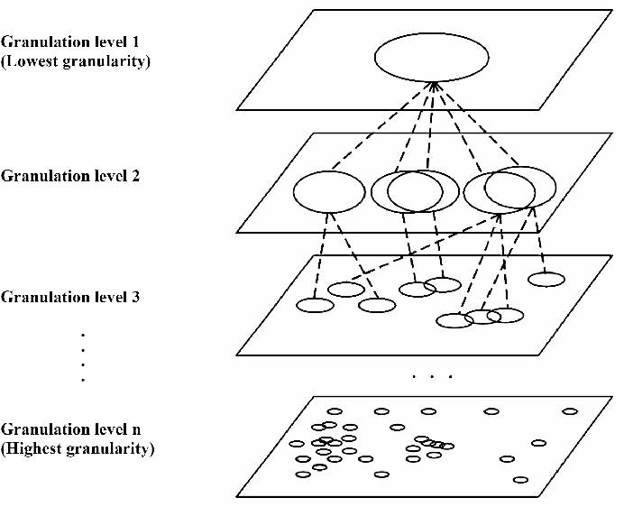
Introduction to Granular Computing
Terminology Alert:
Granule: It refers to a coherent and meaningful unit that encapsulates information. It represents a chunk or cluster of data that exhibits internal homogeneity and external heterogeneity. Granules can be thought of as building blocks that help organize and structure complex information. (Need for information abstraction)
Granularity: It refers to the level or scale at which information is organized, represented, or processed. It pertains to the degree of detail or coarseness in the division of data into granules. Granularity determines the size or extent of the individual granules and how they relate to each other in terms of their hierarchical or overlapping nature. (Knowledge of abstraction level)
Figure: Granules and granulation levels

Slide 11
Introduction to Granular Computing
Terminology Alert:
To illustrate the difference, imagine a dataset containing information about people's ages. Granules in this context could represent different age groups, such as children, teenagers, adults, and seniors. The granularity, on the other hand, would refer to the level of detail or the size of these age groups. For instance, a coarse granularity might divide the dataset into just two groups: under 18 and 18 or above, while a finer granularity could divide the ages into smaller intervals, such as 0-5, 6-12, 13-17, 18-25, and so on.
Figure: Granules and granulation levels

Slide 12
PART 2: Granular computing frameworks
Fuzzy sets and Rough sets

Slide 13
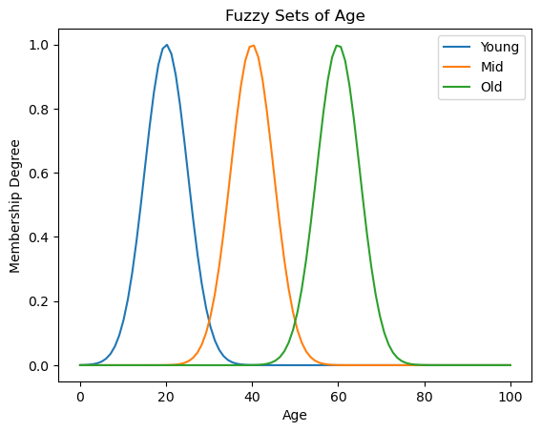
Granular Computing Frameworks
FUZZY SETS
Fuzzy sets are a mathematical framework introduced by Lotfi Zadeh in the 1960s as an extension of classical set theory.
Classical/Crisp set 0 or 1.
Fuzzy sets allow for partial membership or degrees of membership
Useful in dealing with ambiguity or uncertainty
Figure: Fuzzy sets example

Slide 14
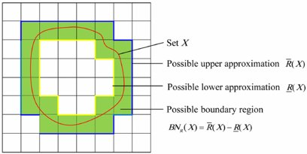


Granular Computing Frameworks: Roughsets
Rough sets is a mathematical framework developed by Polish computer scientist Zdzisław Pawlak in the early 1980s.
Rough set theory is particularly useful in dealing with incomplete or imprecise information
The fundamental concept in rough sets is the notion of an approximation. It allows us to classify objects into two sets: the lower approximation and the upper approximation.
The lower approximation represents the set of objects for which we have complete information. (set of objects that positively belong to the target set)
The upper approximation represents the set of objects that may or may not belong to the target set based on the available information. (set of objects which possibly belong to the target set)
Pawlak, Zdzisław. "Rough sets." International journal of computer & information sciences 11 (1982): 341-356.

Slide 15
Granular Computing Frameworks
U | Headache | Temp. | Flu?
O1 | Yes | Normal | No
O2 | Yes | High | Yes
O3 | Yes | V. High | Yes
O4 | No | Normal | No
O5 | No | High | No
O6 | No | V. High | Yes
O7 | No | High | Yes
O8 | No | V. High | No
Indiscernibility:
R = {Headache, Temp.} = {O1}, {O2}, {O3}, {O4}, {O5, O7}, {O6, O8}
Set approximation:
X1 = {u | Flu(u) = yes } = {O2, O3, O6, O7}
R_LX1 = {O2, O3}
R_UX1 = {O2, O3, O6, O7, O8, O5}
X2 = {u | Flu(u) = No} = {O1, O4, O5, O8}
R_LX2 = {O1, O4}
R_UX2 = {O1, O4, O5, O8, O7, O6}
Table: Information/ Decision Table

Slide 16
PART 3: Granular computing applications
Extracting Classification Rules using GRC

Slide 17
Applications of Granular Computing
Domain of application | Contribution
Data Analysis and Knowledge Discovery | Valuable for data mining, pattern recognition, and knowledge discovery. By dividing large datasets into meaningful granules, it becomes easier to identify relevant patterns, extract essential features, and discover hidden knowledge.
Decision Support Systems | Representing and processing data at different levels of granularity, in order to handle uncertainty, ambiguity, and incomplete information
Artificial Intelligence and Machine Learning | Providing a foundation for handling uncertainty and imprecision. (Example: Fuzzy logic)

Slide 18

Induction of Classification Rules using Granular Computing: A DEMO
Object​ | Height​ | Hair​ | Eyes​ | Class​
O1​ | short​ | blond​ | blue​ | 1​
O2​ | short​ | blond​ | brown​ | 0​
O3​ | tall​ | red​ | blue​ | 1​
O4​ | tall​ | dark​ | blue​ | 0​
O5​ | tall​ | dark​ | blue​ | 0​
O6​ | tall​ | blond​ | blue​ | 1​
O7​ | tall​ | dark​ | brown​ | 0​
O8​ | short​ | blond​ | brown​ | 0​
Table: Information table

Slide 19
Induction of Classification Rules using Granular Computing: A DEMO
Formula​ | Granule​
Height = short​ | {O1,O2,O8}​
Height = tall​ | {O3,O4,O5,O6,O7}​
Hair = blond​ | {O1,O2,O6,O8}​
Hair = red​ | {O3}​
Hair = dark​ | {O4,O5,O7}​
Eyes = blue​ | {O1,O3,O4,O5,O6}​
Eyes = brown​ | {O2,O7,O8}​
Table: Basic granules

Slide 20




Induction of Classification Rules using Granular Computing: A DEMO
Absolute Support
(Confidence )
Generality
Coverage
Conditional Entropy

Slide 21
Induction of Classification Rules using Granular Computing: A DEMO
Formula​ | Granule​ | Generality​ | Confidence ​ |  | Coverage​ |  | Entropy​
 |  |  | 1​ | 0​ | 1​ | 0​
Height = short​ | {O1,O2,O8}​ | 3/8​ | 1/3​ | 2/3​ | 1/3​ | 2/5​ | 0.92​
Height = tall​ | {O3,O4,O5,O6,O7}​ | 5/8​ | 2/5​ | 3/5​ | 2/3​ | 3/5​ | 0.97​
Hair = blond​ | {O1,O2,O6,O8}​ | 4/8​ | 2/4​ | 2/4​ | 2/3​ | 2/5​ | 1​
Hair = red​ | {O3}​ | 1/8​ | 1/1​ | 0/1​ | 1/3​ | 0/5​ | 0​
Hair = dark​ | {O4,O5,O7}​ | 3/8​ | 0/3​ | 3/3​ | 0/3​ | 3/5​ | 0​
Eyes = blue​ | {O1,O3,O4,O5,O6}​ | 5/8​ | 3/5​ | 2/5​ | 3/3​ | 2/5​ | 0.97​
Eyes = brown​ | {O2,O7,O8}​ | 3/8​ | 0/3​ | 3/3​ | 0/3​ | 3/5​ | 0​
Table: Basic granules and their measures

Slide 22
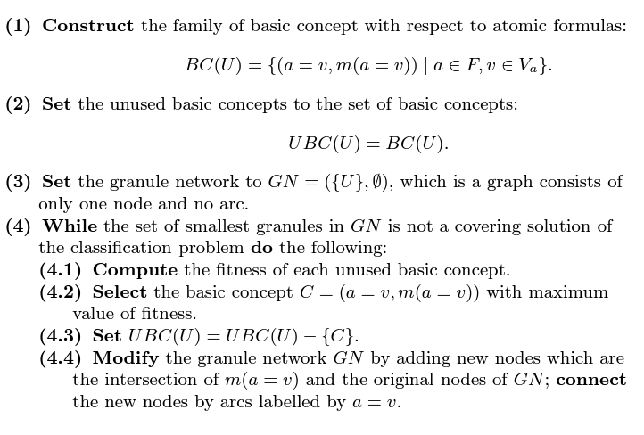
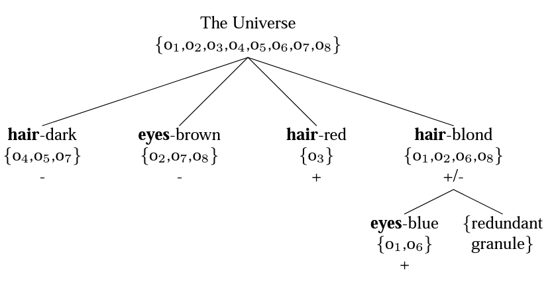
Induction of Classification Rules using Granular Computing: A DEMO
Algorithm: An algorithm for constructing the granular tree
Figure: Granular tree

Slide 23
Induction of Classification Rules using Granular Computing: A DEMO
Demo 1: Induction of Classification Rules by Granular Computing - Prof. Y.Y.Yao
Demo 2: Rule Extraction for Screening of COVID-19 Disease Using Granular Computing Approach
Demo 3: To play or not to play - GrC Rule Extraction
Demo 4: VM consolidation improvement approach using heuristics granular rules in cloud computing environment

Slide 24
THANK YOU
Idriss JAIRI
Email: idriss.jairi@univ-lille.fr

